Slide 1
Analysis of Climate Models
Caroline, Dario, Yoni

Slide 2
Climate models
Lay a finite grid over the globe
Try to model the main physical and chemical processes as best as possible.
Models are ~1 million lines of code, made up of interchangeable modules.
Modules are often reused, swapped around and shared within and between modelling groups/centers.
Not independent samples from “space of all models”!

Slide 3
Data: model output
Coupled Model Intercomparison Project (CMIP) Phase 5
Hosted on ETH Servers
In total: 17TB, temperature alone 3TB
But: Monthly data smaller (for temperature “only” 250GB)
Netcdf format

Slide 4
Model Uncertainty
3 kinds of uncertainties:
Model uncertainty: simulated physical processes are wrong*.
Scenario uncertainty: Projected Carbon emissions are wrong*.
Initial condition uncertainty: Initial conditions have error/might be missing.
Scenario uncertainty important for long-term, initial condition uncertainty for short-term, model uncertainty always important.
Problem: How do we measure these uncertainties??
Takeaway: be wary of policy based on these model!

Slide 5
Model ensembles
Run different models under different scenarios, and combine their results.
Used to get “more robust” forecasts.
Fundamental dilemma: For most statistical inference, independence assumptions are used (i.e. confidence interval).
Problem: in lieu of co-dependence, can we at least say how different these models are? How do we measure “distance” between models?

Slide 6
Our preliminary ideas
Define different metrics to measure distance between models
use Euclidean distance
Use general principal component analysis to define weight matrix
Find a more sophisticated way of looking at inter-model distances (e.g. Tensor decomposition)
How do relationships between models change when we change scenarios or ensembles?
Problems for all approaches: Models are tuned to fit observations well (no organization wants to have an “outlier” model, even though this could prove useful).

Slide 7
Current challenges
No database that comprehensively describes all the models.
There appear to be some serious problems with the data internally.
Without ground-truth observations, there is no low-hanging fruit.
Try fancy clustering / higher dimensional MDS
Think of models as defining a convex set of a higher dimensional manifold how can we sample randomly from the surface of this shape?
Find new ways of visualizing the data and performing EDA
Next steps

Slide 8
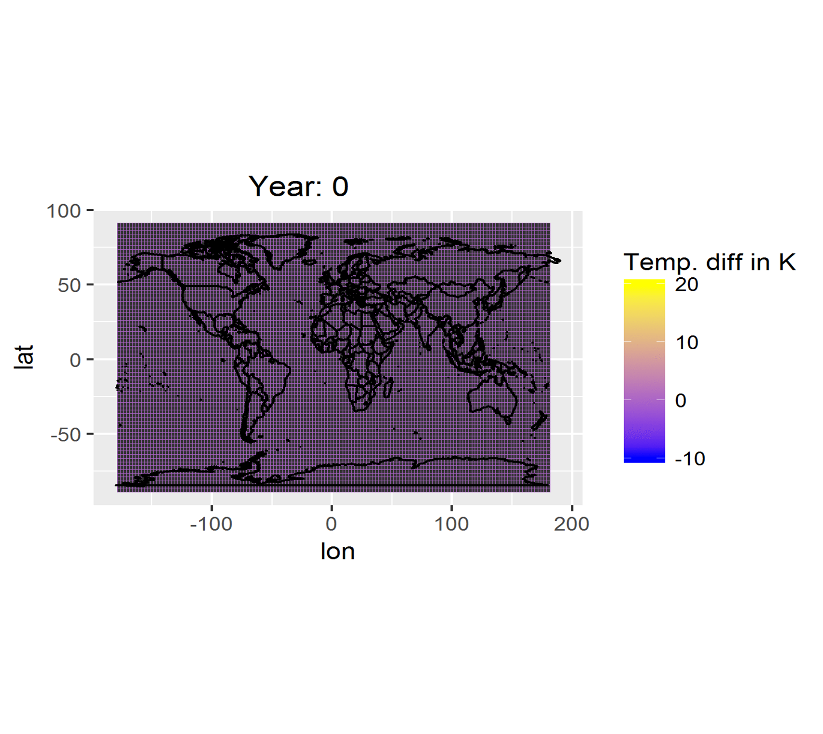
Exploratory Data Analysis

Slide 9
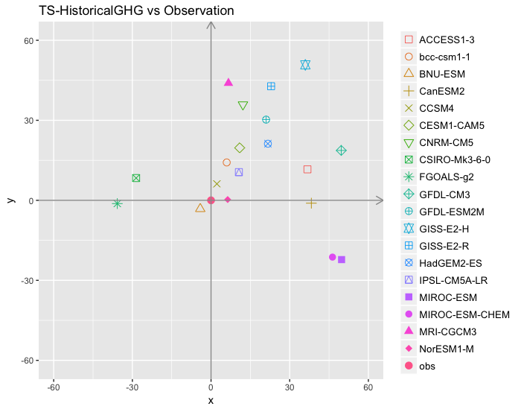
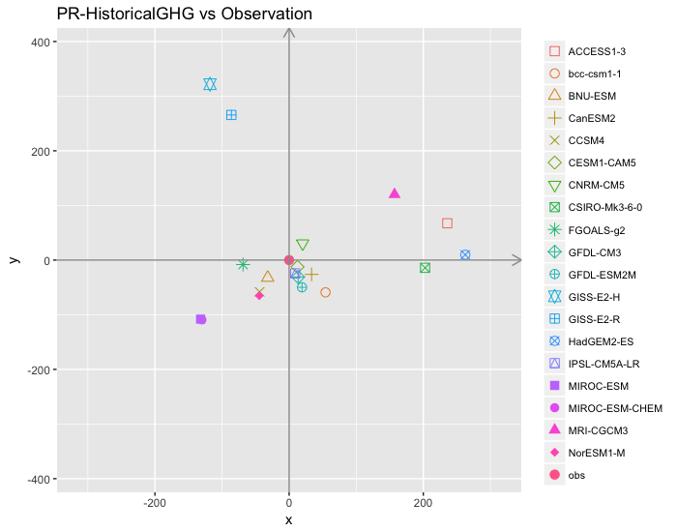
Multidimensional Scaling

Slide 10
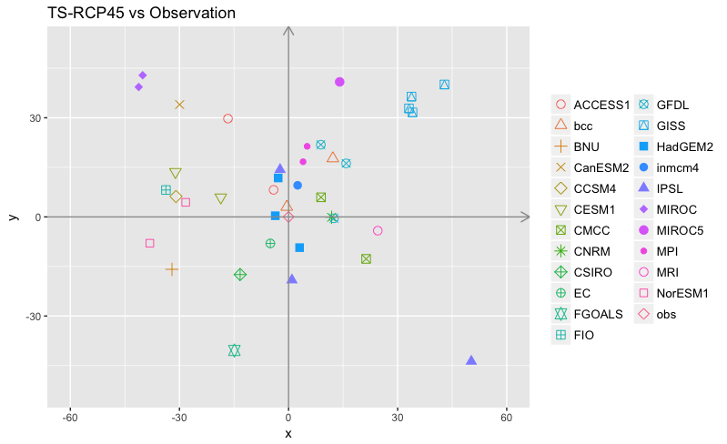
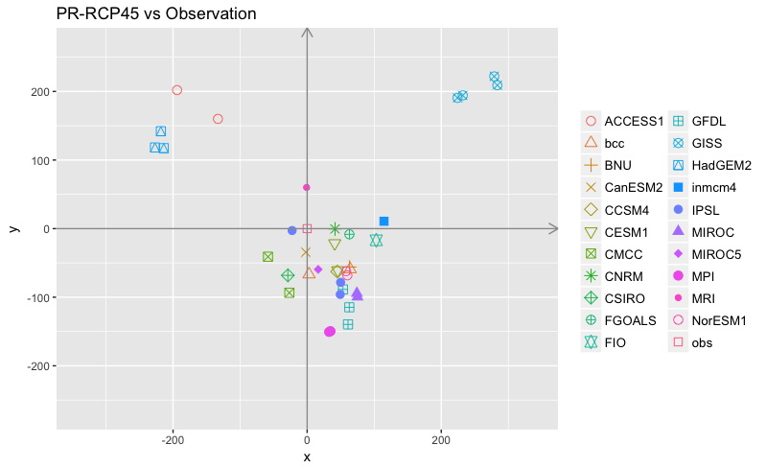

Slide 11
MDS After compressing:
Mean
Derivative & Variance
Variance

Slide 12
We have some tool tips for you!
(if you need them…)

Slide 13
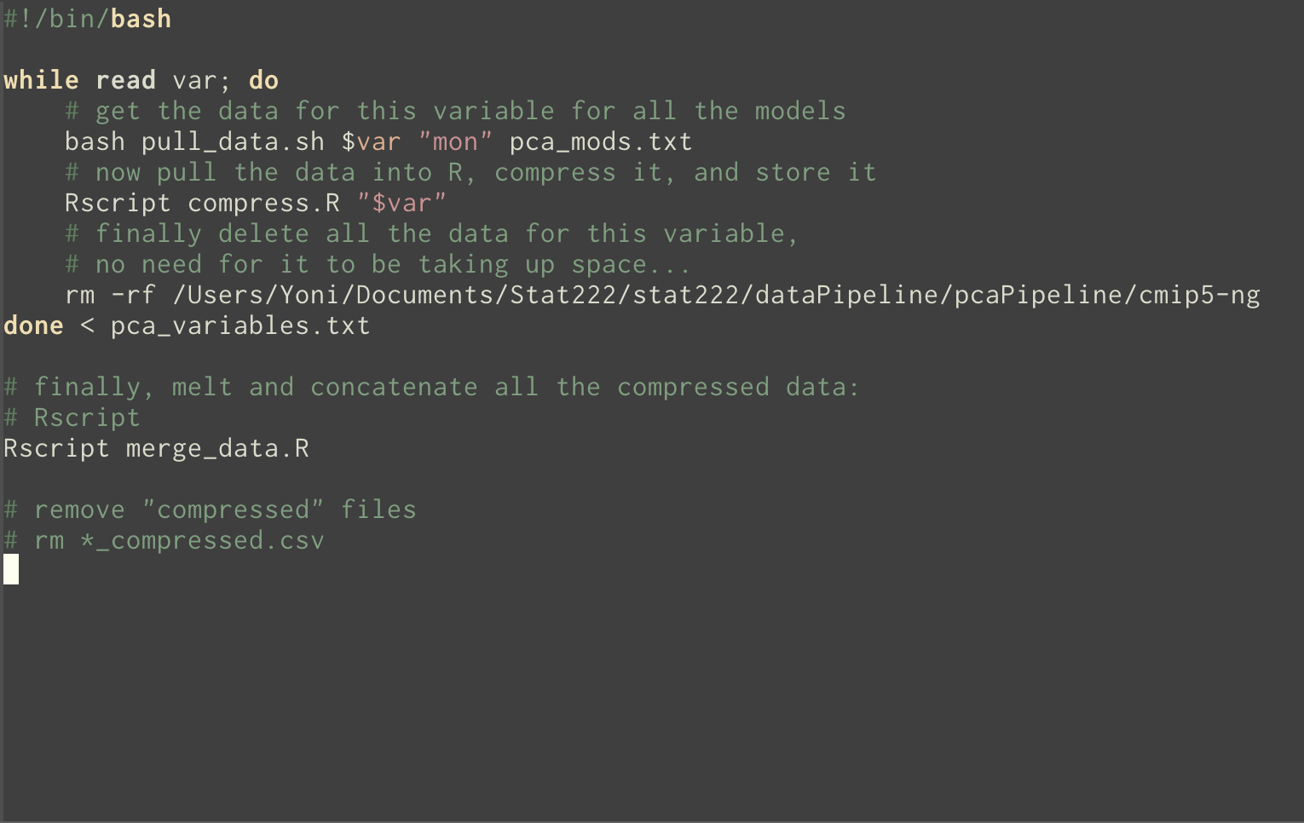

Slide 14
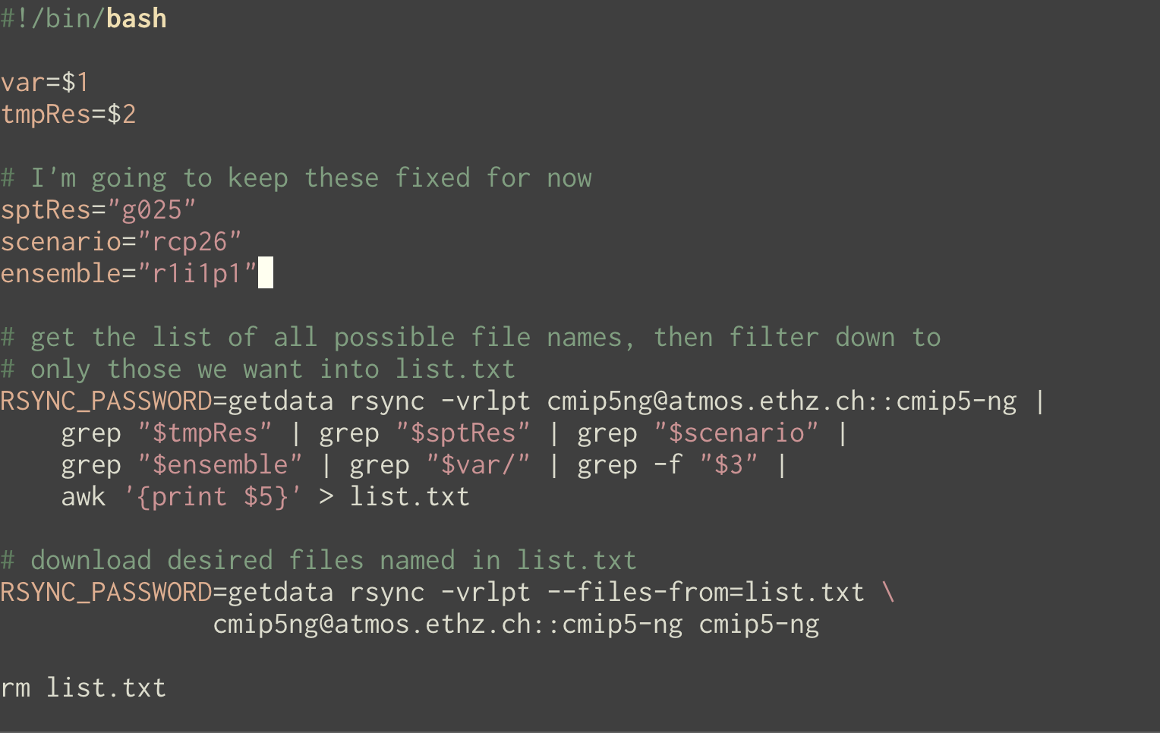

Slide 15
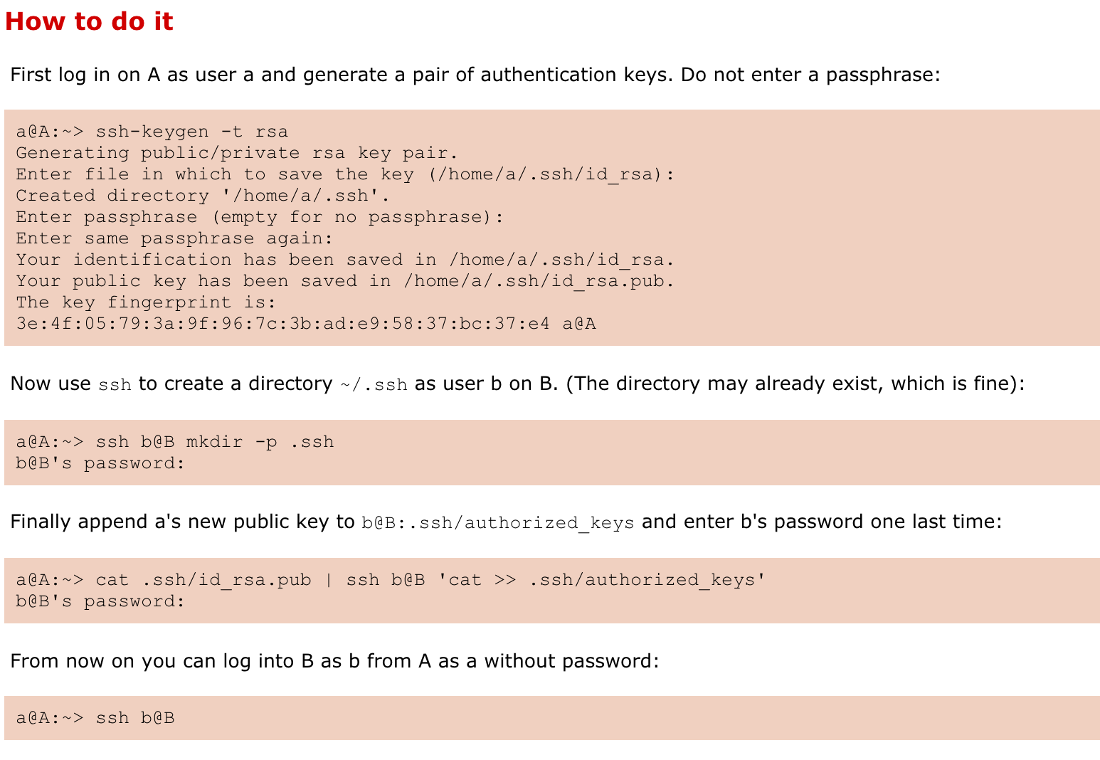
ssh without a password!

